Slide 1

DEPARTMENT OF PHYSICS
SRM INSTITUTE OF SCIENCE AND TECHNOLOGY
18PYB103J –Semiconduuctor Physics
Concepts of Optical Recombination and emission process

Slide 2
When a semiconductor is illuminated with light an electron in the valence band making an upward transition to conduction band.
This results electron-hole pair generated, the reverse process of electron-hole annihilation is called recombination.
Recombination process may be radiative or non- radiative
1. If electron annihilated with hole energy is released equal to E ≥ Eg called radiative
recombination, in this process a photon of energy E= hν is released
2. If electron annihilated with hole energy is released equal to E < Eg called non radiative recombination, in this process phonons are released

Slide 3
Recombination electron – hole pairs observed in different optical process
Luminescence: Process where electron hole pairs created and recombined radiatively
Photoluminescence: electron- hole pairs are generated due to absorption of light and recombination occurs
radiatively
Cathodluminescence: electron – hole pairs are generated by the electron bombardment, and radiative recombination occurs
Electroluminescence: process of radiative recombination following injection with pn-junction or similar
device.

Slide 4


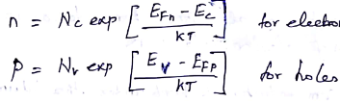
When a semiconductor is under equilibrium without any incident photon (or) injection of electron the carrier density can be calculated from an equilibrium Fermi level using Fermi Dirac statistics
But when light is illuminated non equilibrium carrier concentration is created and above relation is not valid, hence Fermi Dirac distribution for electrons and holes in non equilibrium condition are
Further carrier concentration is calculated as

Slide 5
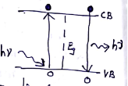

The excess carriers generated in semiconductor at non equilibrium condition must eventually recombine
Generation rate (G) = recombination rate (R)
The generation recombination process involves transition of charge carriers across the energy bandgap
and is different for direct & indirect bandgap semiconductor materials.
The probability of radiative recombination is very high and direct bandgap semiconductors
due to momentum & energy conservation
Recombintaion rate of charge carriers is depends upon the lifetime charge carriers
In general both radiative and noradiative recombinations are considered, the total life time is given as

Slide 6
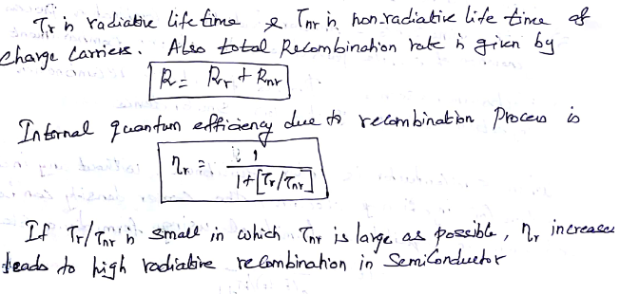

Slide 7
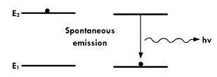
Emission process:
Generally the emission process are takes place in two types in optical devices
Spontaneous emission
Stimulated emission
Spontaneous emission: spontaneous emission, this process requires a conduction band
energy state occupied by an electron and an empty valence band energy state. The electron Itself transit from conduction band to valence band spontaneously by releasing a photon.
This photon has a random direction and phase.
This is the opposite of the common situation in equilibrium, but at a finite temperature
there will be a small number of full states in the conduction band and empty states in the
valence band. Also, electrons and holes can be created via optical absorption and other
pumping mechanisms.

Slide 8
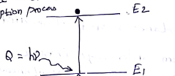

Absorption:
Let us consider two energy levels in semiconductor E₁ & E₂
where E₁ corresponds to ground state
E₂ corresponds to exited state
At room temperature most of the electrons are in ground state
When photons of energy greater or equal to bandgap incident on
Semiconductor electron hole pairs are generated, this process is
Called absorption
N_{ab} QN₁ => N_{ab} = B₁₂ Q N₁
N_{ab} → number of atoms undergoing absorption process/Vt
N₁ → number of atoms in E₁ / V
Q → energy density of incident radiation
B₁₂ → proportionality constant

Slide 9
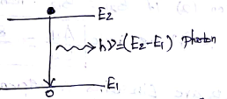
Spontaneous emission:
When electron hole pairs are generated due to the absorption of incident radiation.
After a short time without any external stimulus the electron come back from
Unstable exited to state (E₂) to ground state (E₁) by emitting a photon of energy
hν ≥ E₂-E₁
This process is called spontaneous emission
Then N_{sp} N₂ => N_{sp} = A₂₁ N₂
N_{sp} → is the number of atoms undergoing spontaneous emission process/vt
N₂ → number of atoms in E₂ / V
A₂₁ → proportionality constant

Slide 10
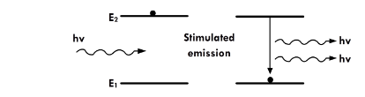
Stimulated emission:
An incident photon causes an upper level atom to decay, emitting a “stimulated” photon whose properties are identical to those of the incident photon.
The term “stimulated” underlines the fact that this kind of radiation only occurs if an incident photon is present

Slide 11
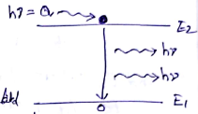
Stimulated emission:
If a photon of energy (hν) impinges on the electron which is presented in
Exited state (E₂).
The electron stimulated back to the ground state by releasing the energy
hν ≥ E₂-E₁ which is phase with the incident radiation this process is called
stimulated emission.
N_{st} = B₂₁ Q N₂
N_{st} → number of atoms undergoing stimulated process/Vt
N₂ → number of atoms in E₂ / V
Q → energy density of incident radiation
B₂₁ → proportionality constant

Slide 12
